Slide 1


STACK OVERFLOW DEVELOPER SURVEY 2019
Y.Laharika
09-04-2024

Slide 2

OUTLINE
Executive Summary
Introduction
Methodology
Results
Visualization – Charts
Dashboard
Discussion
Findings & Implications
Conclusion
Appendix

Slide 3

EXECUTIVE SUMMARY
• Data contextualization and analysis goal.
• Methodology description.
• Data gathering.
• Data analysis.
• Data visualizations.
• Results presentation supported with graphs and trends.
• Discussion of overall findings and implications regarding
the results previously exposed.
• Final conclusions of the carried out research.

Slide 4

INTRODUCTION
• Stack Overflow’s annual Developer Survey is the largest
and most comprehensive survey of people who code
around the world.
• Results don’t represent everyone in the developer
community evenly.
• Nearly 90,000 developers.
• Trends to predict where the developers are going.
• Characterization of developers around the globe

Slide 5

METHODOLOGY
• Collect survey data & explore its content
• Web Scraping
• APIs.
• Request library.
• Data Wrangling
• Exploratory data analysis
• Analyzing data distribution.
• Handling outliers.
• Correlations.
• Data Visualization
• Highlight distribution of data, relationships, the composition and
comparison of data.
• Dashboards

Slide 6
RESULTS

Slide 7
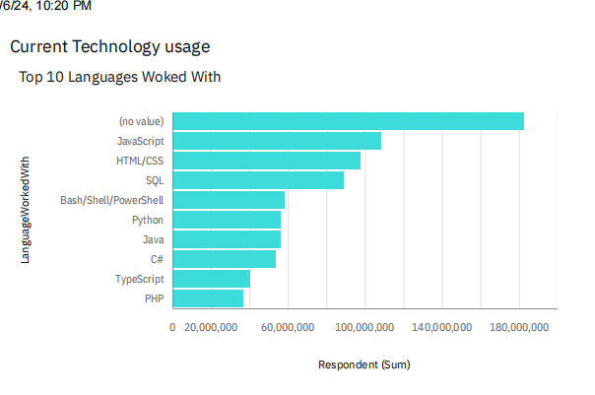
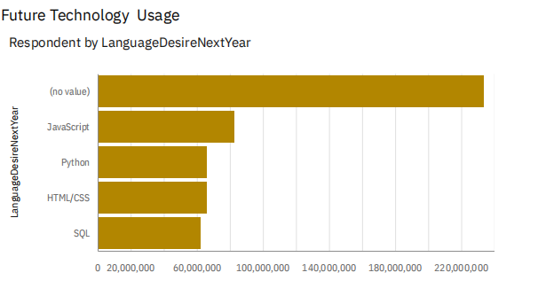
PROGRAMMING LANGUAGE TRENDS
Current Year
Next Year

Slide 8
PROGRAMMING LANGUAGE TRENDS - FINDINGS & IMPLICATIONS
Findings
• JavaScript seems to keep as
leading language.
• Python fastest-growing.
• Great interest in TypeScript
Implications
• Possible developers migration
from JavaScript to TypeScript.

Slide 9
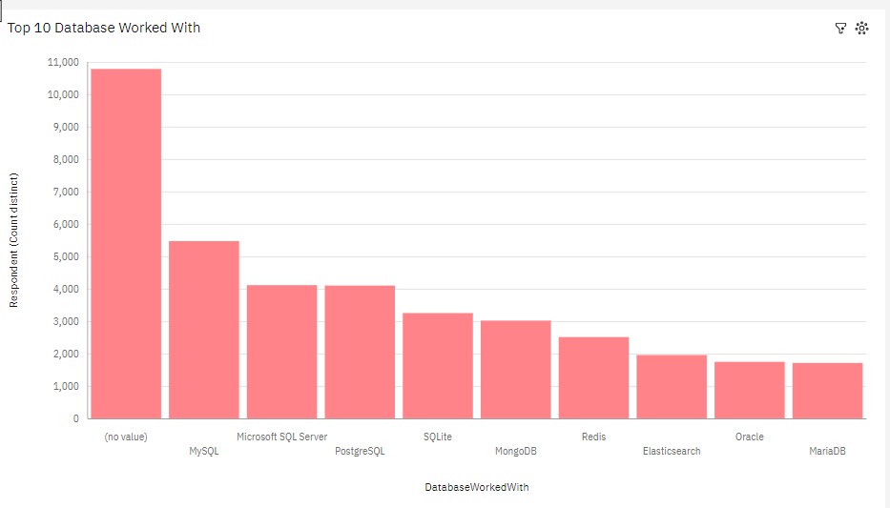
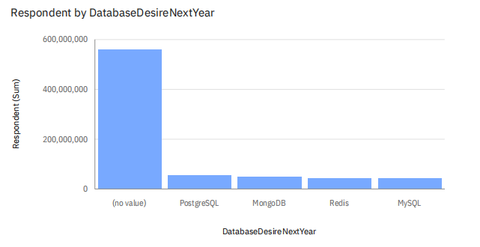
DATABASE TRENDS
Current Year
Next Year

Slide 10
DATABASE TRENDS - FINDINGS & IMPLICATIONS
Findings
• MySQL as most used database.
• Lack of interest in Microsoft SQL
Server and SQLite.
• Increasing interest in PostgreSQL
and MongoDB.
Implications
• Microsoft SQL Server and SQLite
losing ground in the market.
• PostgreSQL and MongoDB
establishment in the mark

Slide 11

DASHBOARD
https://github.com/laharika114/Dash-Board-Project

Slide 12
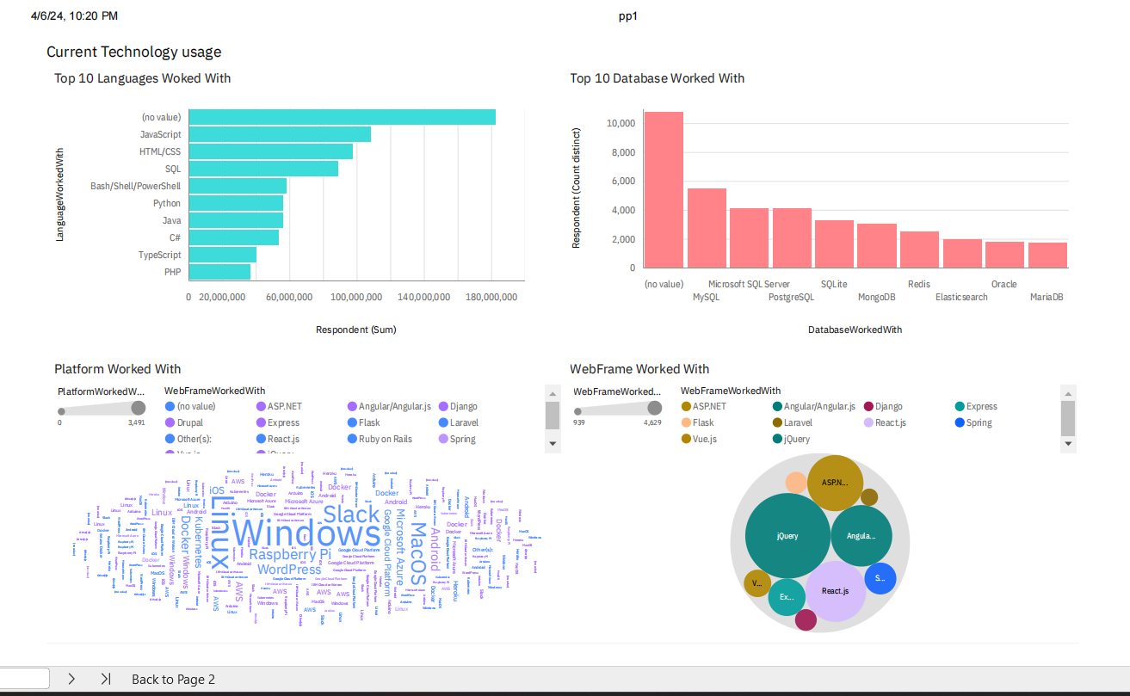
DASHBOARD TAB 1

Slide 13
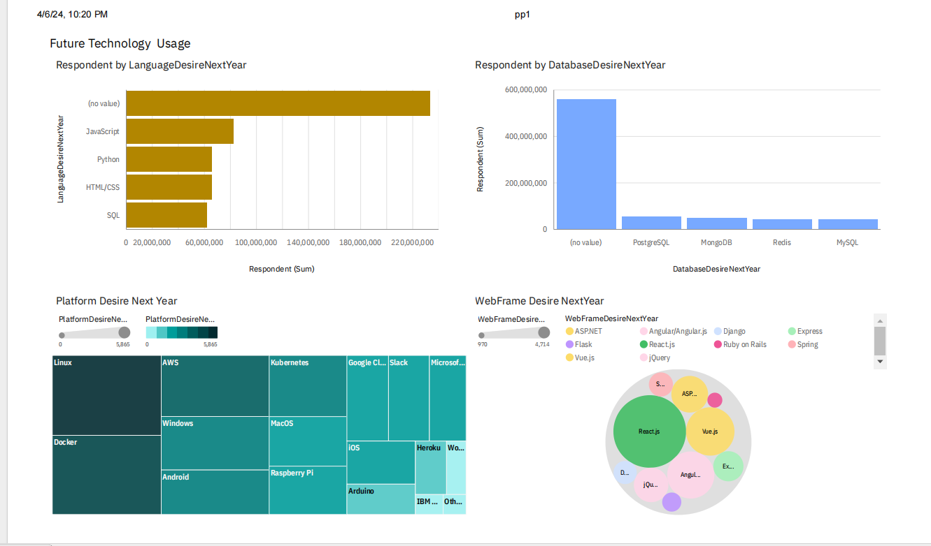
DASHBOARD TAB 2

Slide 14
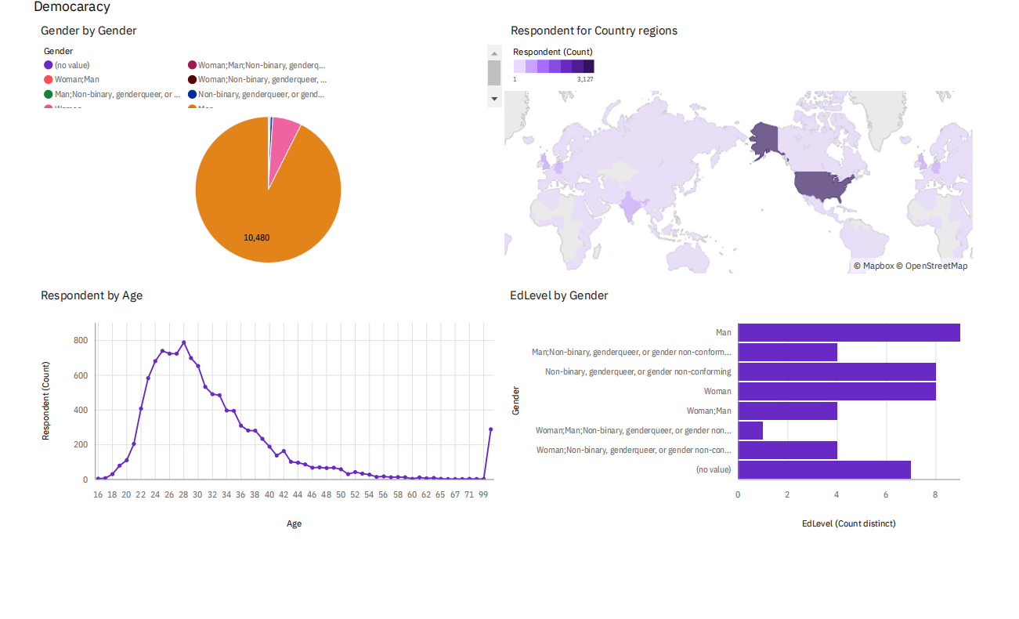
DASHBOARD TAB 3

Slide 15
DISCUSSION

Slide 16
OVERALL FINDINGS & IMPLICATIONS
Findings
• JavaScript widely used and
TypeScript getting popular.
• Over 90% young male
developers.
• Developers mostly located in
developed countries.
Implications
• JavaScript and TypeScript web
frames gaining followers.
• Global polarization of developers
location and gender.
• Young developers without
postgrad studies on its majority

Slide 17

CONCLUSION
• Developers are people with very marked
characteristics.
• A good idea of popularity trends of different
tools, platforms and languages can be
obtained.
• There is a job to be done to spread
accessibility of this labor market to
countries in development

Slide 18

APPENDIX

Slide 19
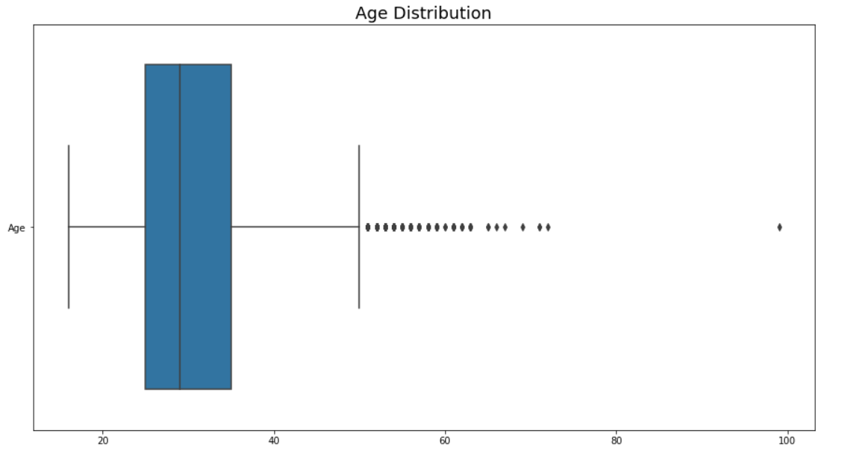
JOB POSTINGS

Slide 20
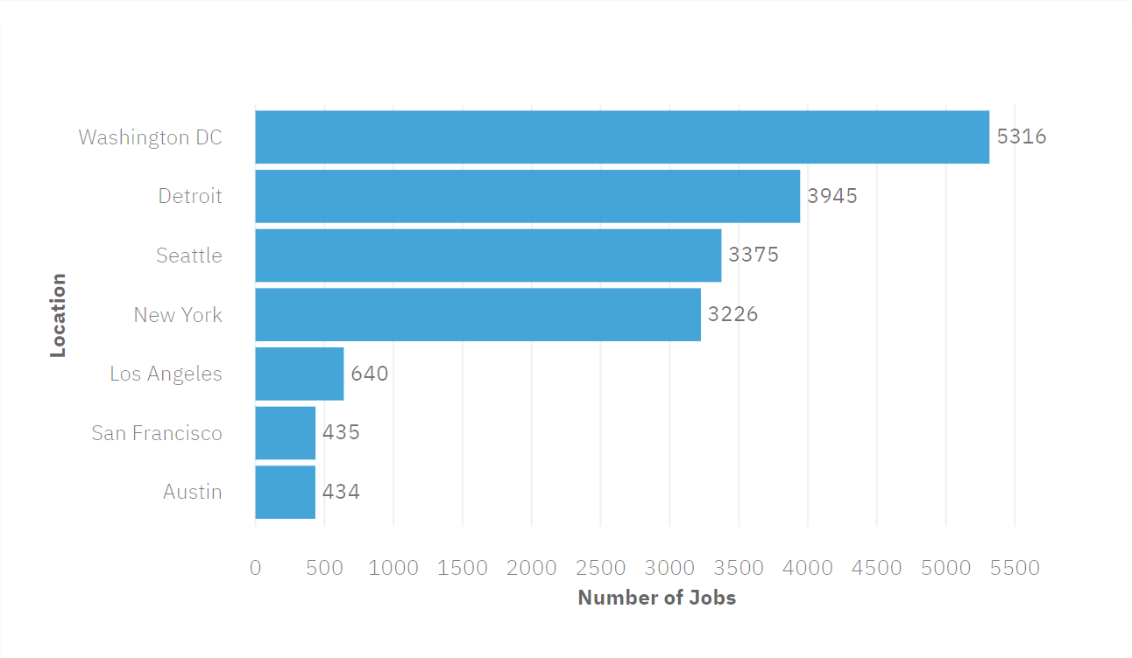
POPULAR LANGUAGES

